Slide 1






Agri-Pro
Team
Mayar Mohamed
Fatma Hassan
Maram Mahmoud
Mohamed Salah
Abo-Alfadl Ramadan
Ali Mohsen
Supervisor
Dr.Abd El-Rahim Sadiq

Slide 2
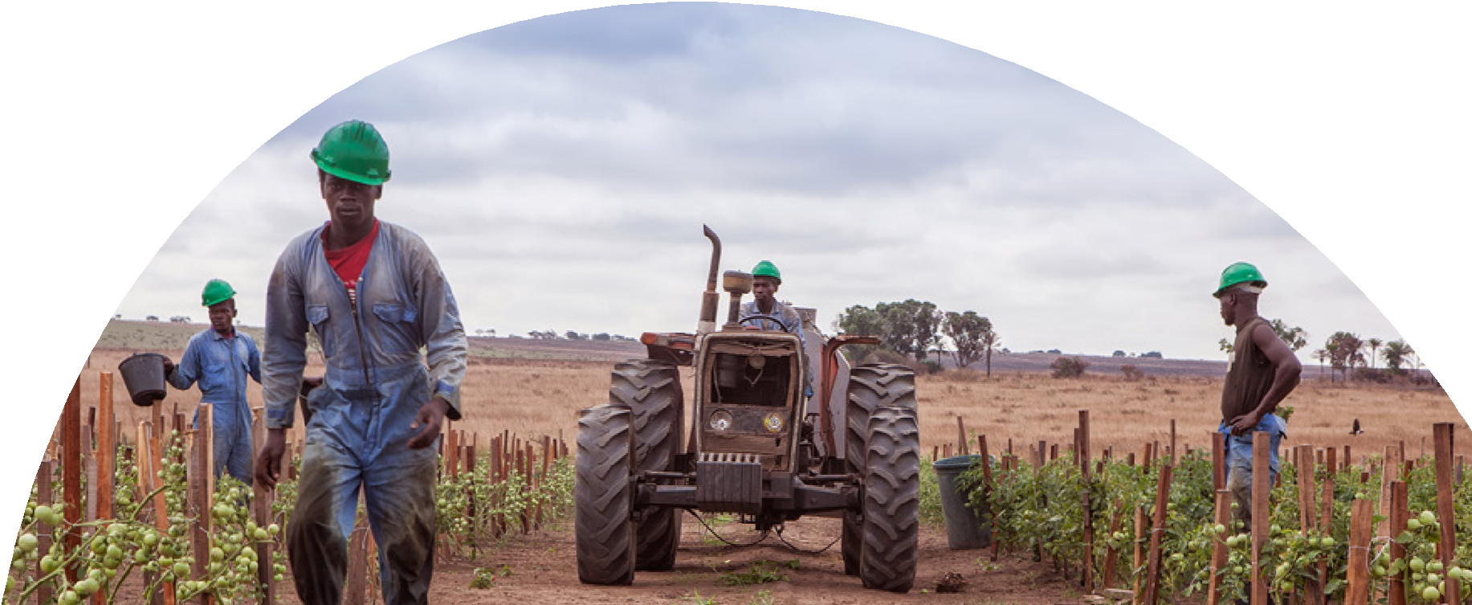
Abstract
Primary stakeholders include farmers, investors, and buyers, while secondary stakeholders such as governmental bodies, agricultural institutions, and domain experts benefit from verified data and analytical insights. The system boundaries exclude online payment processing, logistics, and fully automated farming operations. Implemented with React.js for the front-end and Node.js with Express.js for the back-end, the platform represents a significant advancement in structuring agricultural investment and promoting sustainable agricultural development in Egypt.
The Agricultural Investment and Management Platform is a web-based digital solution designed to address critical inefficiencies in Egypt’s agricultural sector, including fragmented investment workflows, limited operational transparency, and suboptimal communication between farmers, investors, and buyers. The platform provides a robust and structured environment to facilitate organized agricultural investment, comprehensive farm management, and direct market connectivity.
The system is composed of three core modules. The Investment System allows farmers to present their projects and enables investors to fund them in a fully transparent and accountable manner, supporting informed decision-making. The Management System delivers end-to-end project and farm management capabilities, including task and expenditure tracking, documentation management, real-time monitoring, smart contract execution, productivity and weather analysis, and profit allocation. The Agricultural Marketplace establishes a direct channel for farmers to showcase and sell their products post-harvest, minimizing reliance on intermediaries and enhancing market efficiency.

Slide 3
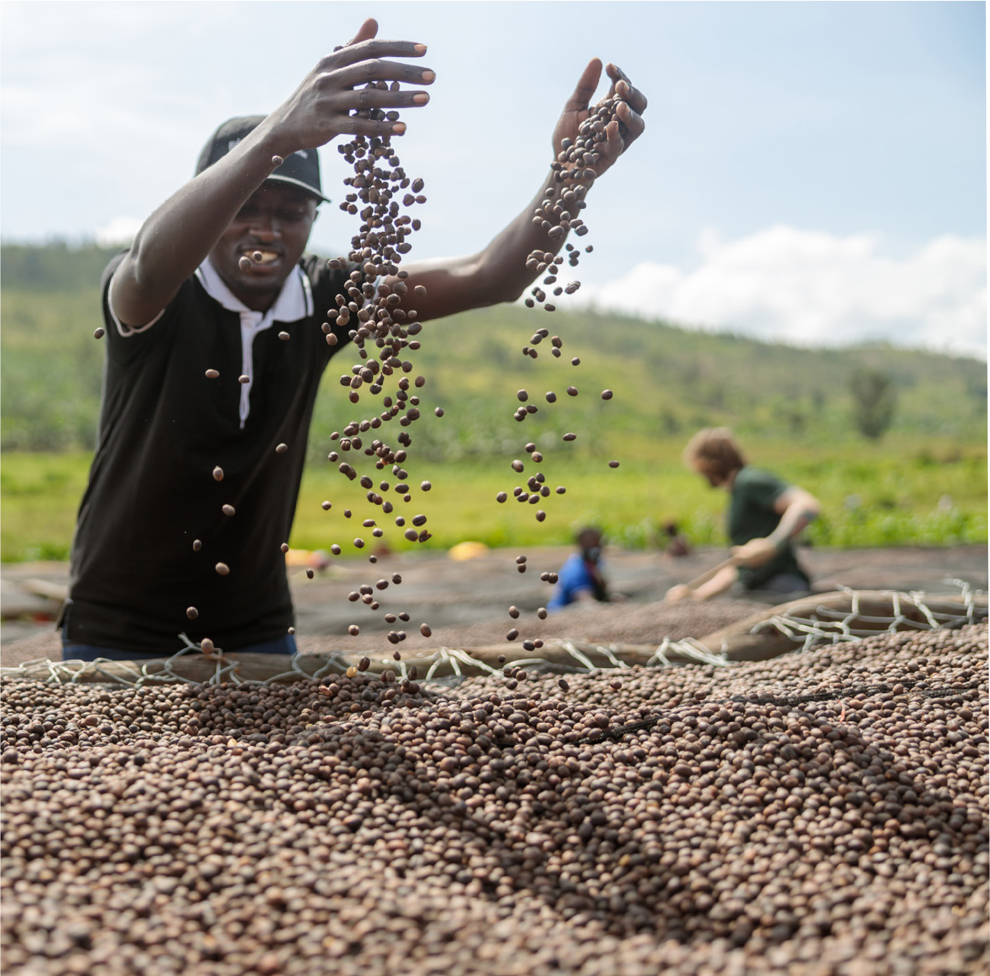




Motivation
Agriculture is a vital sector in Egypt, contributing to the economy, employment, and food security. However, agricultural investment remains weak, fragmented, and poorly digitized, despite the sector’s high potential.
The agricultural market in Africa and the Middle East is expected to exceed $1 trillion by 2030, highlighting major growth opportunities for Egypt. Yet, limited data, low transparency, and weak communication between farmers and investors reduce investment confidence.
This project aims to build a digital agricultural investment platform in Egypt that empowers farmers and provides investors with secure, data-driven investment opportunities.

Slide 4


Problem Statement
Agricultural investment in Egypt faces inefficiency and low trust due to informal communication, manual processes, and lack of a unified digital platform connecting farmers, investors, and buyers.
Key Challenges:
Farmers: No digital records, limited funding access, weak market reach.
Investors: Lack of accurate data, unclear risks, no real-time tracking.
Buyers: Dependence on intermediaries, higher costs, limited access to fresh products.
System-Level Issues: Manual agreements, weak oversight, delayed settlements.

Slide 5
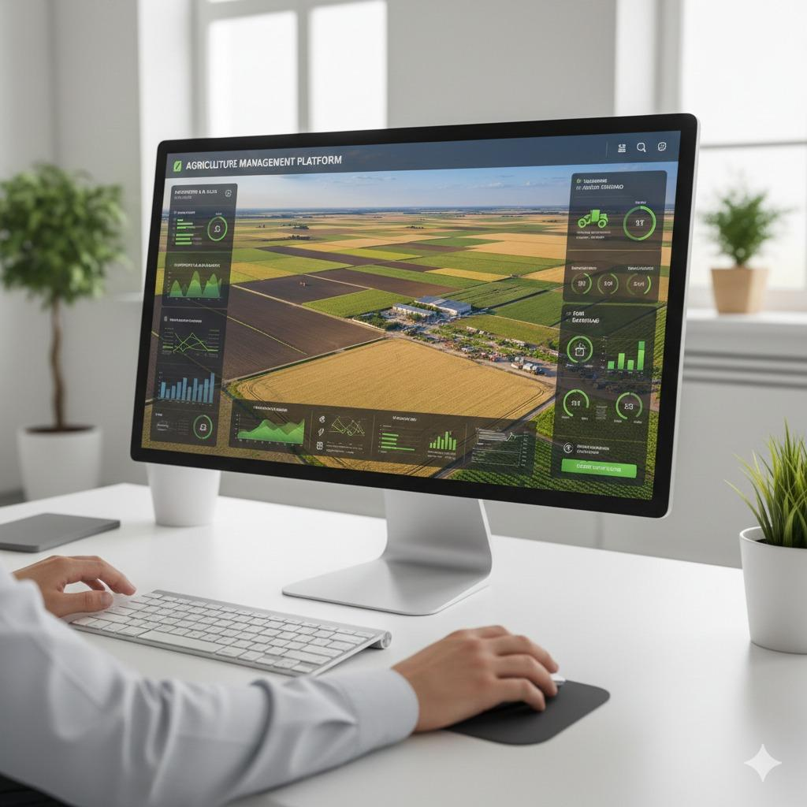
Overview
The Agricultural Investment and Management Platform connects farmers, investors, and buyers to transform agriculture in Egypt.
Investment System:
Farmers share land and crop details; investors browse and fund projects.
Management System:
Tracks the full project lifecycle with smart contracts, real-time monitoring, and automated reporting.
Marketplace:
Farmers showcase crops; buyers contact them directly. Payments and logistics are handled externally.
Goal: Build trust, enable reinvestment, and create a digital, transparent, and data-driven agricultural sector.

Slide 6
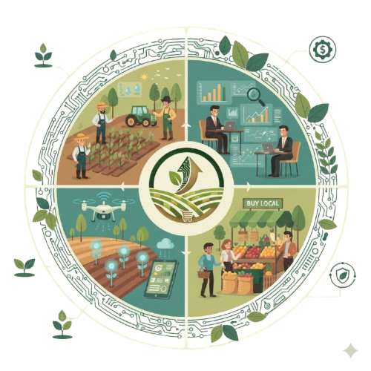
Objectives
Connect farmers, investors, and buyers via a secure, transparent ecosystem.
Help farmers manage data, costs, and risks effectively.
Provide reliable land, crop, and productivity data.
Enable investors to make informed decisions with real-time insights.
Support smart and sustainable agriculture through digital tools.
Ensure transparency across the entire project lifecycle.
Allow farmers direct market access without intermediaries.

Slide 7
System Scope (In-Scope)
Investment System:
Investor dashboard for browsing projects, tracking investments, and analyzing risks.
Financial analysis and reporting tools.
Real-time monitoring, automated settlements, and risk alerts.
Management System:
Farmer dashboard to manage crops, costs, schedules, and performance.
Smart contracts for profit-sharing.
Agricultural Marketplace:
Farmers list and showcase products (photos, quantity, price).
Buyers can search, filter, and contact farmers directly.
Platform-Wide:
Centralized reporting and analytics.
User authentication with multi-role support (Farmer, Investor, Buyer, Admin).

Slide 8
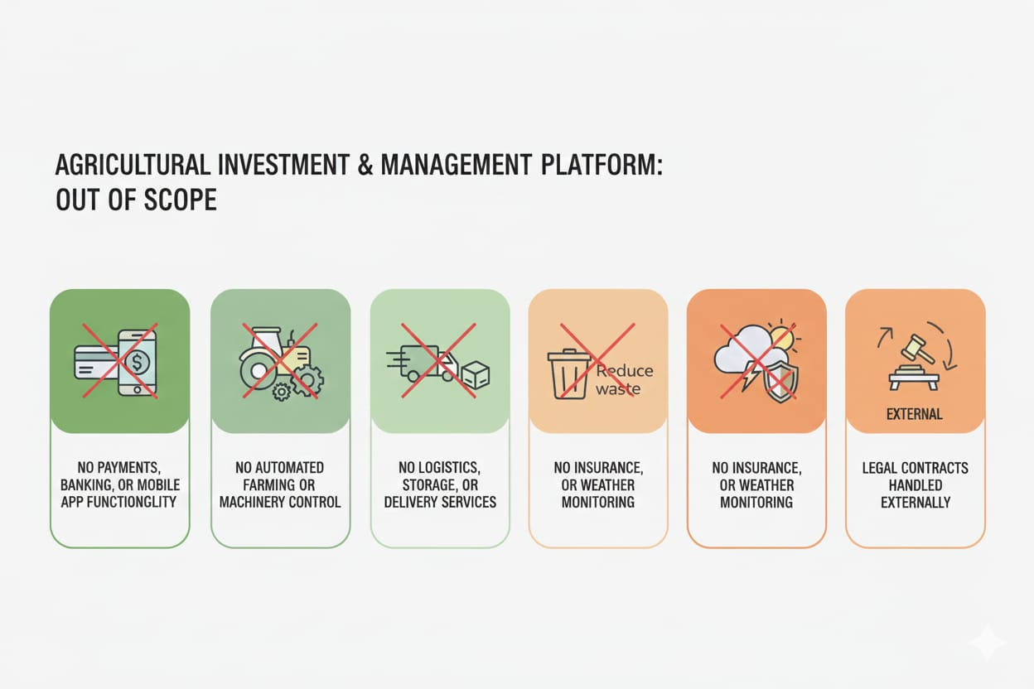
System Scope(Out-of-Scope)

Slide 9
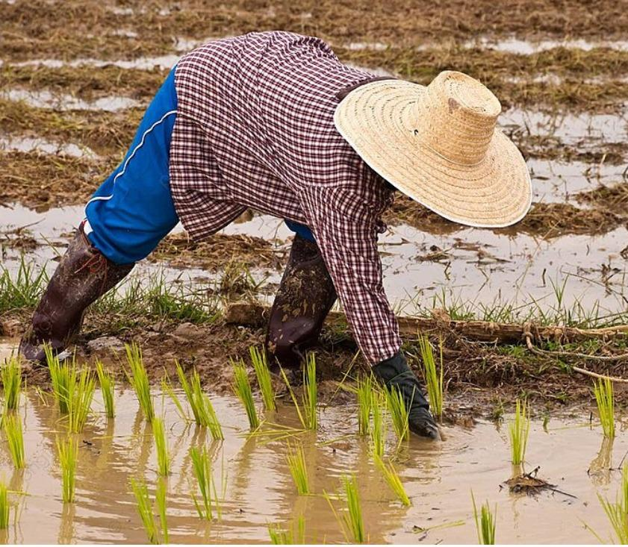
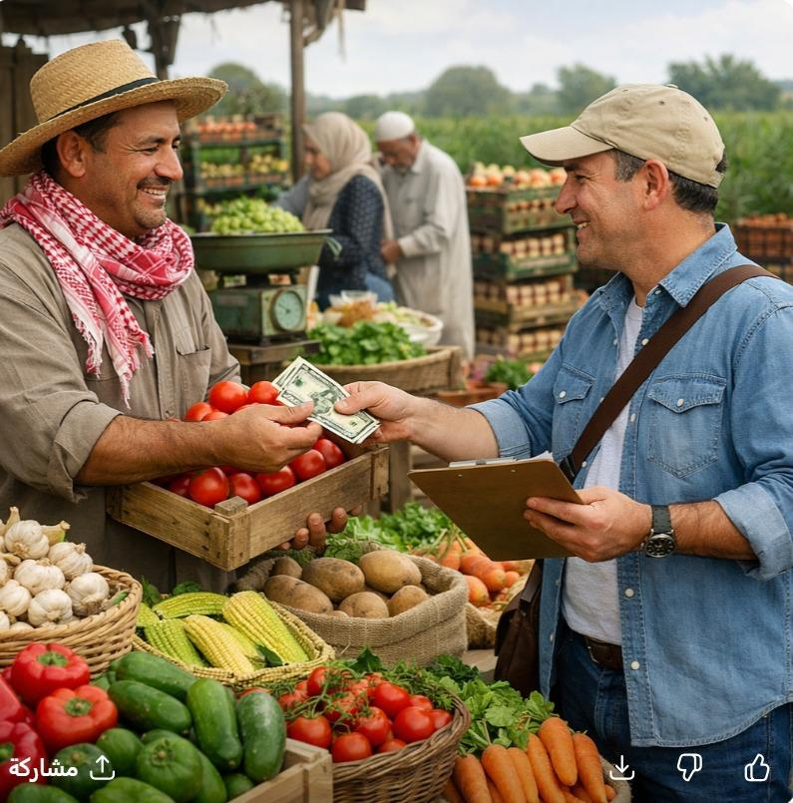
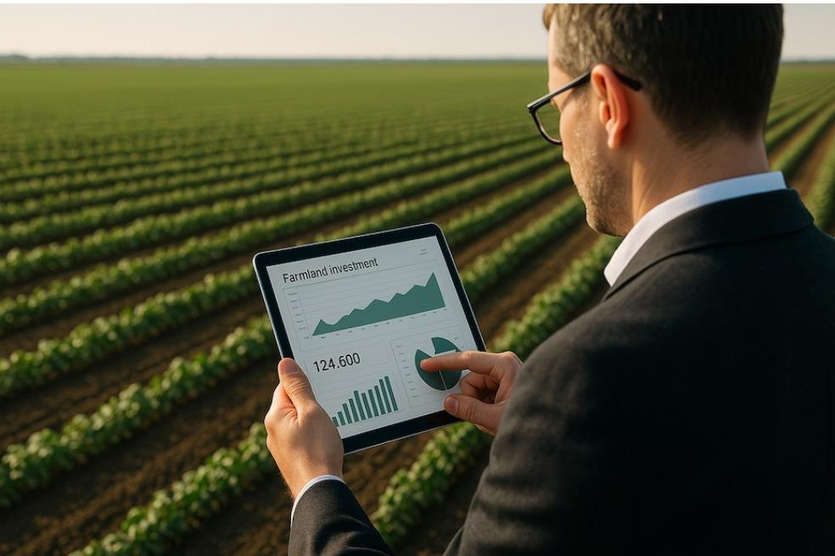
Target Audiance
Primary Users:
Farmers
Investors
Buyers
Secondary Users:
Government agencies.
Institutions
Experts & Consultants

Slide 10
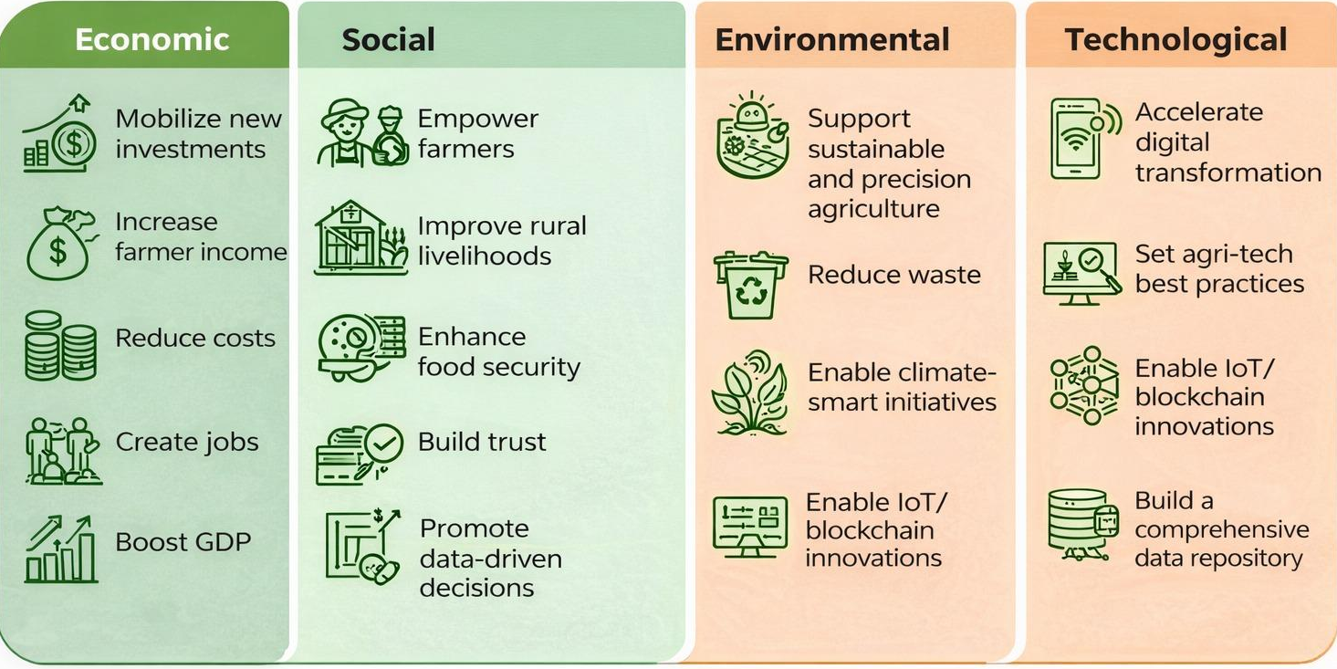
Expected Impact

Slide 11
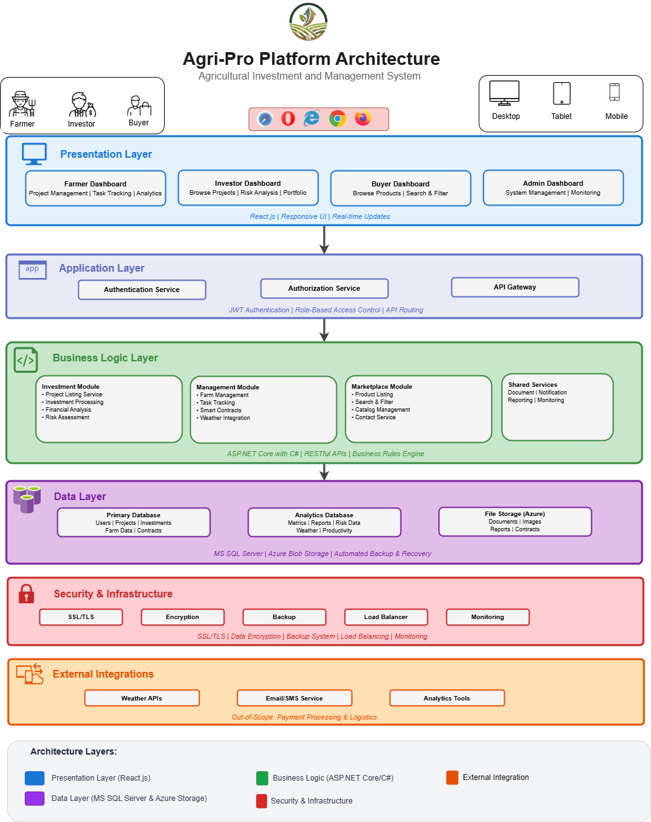
System Architecture

